Slide 1
Teacher Info Slides
What do I need to know before I teach this material?
Notes:
Student slides start at slide #4

Slide 2
Reminders When Answering Questions:
enders When Answering Questions
Set ground rules ahead of time
set up an anonymous question box and give yourself time to formulate answers for the next session
use reliable phrases
always end with a safety message or direction of a reliable resource for more information
tell students you may rephrase questions to protect confidentiality and safety of all students (no names, no questions that expose anyone)

Slide 3
Useful Phrases When Answering Questions:
some people may...
although not everyone will…
it’s important to understand the safety of…
experts believe...
doctors suggest...
the safest way…(always end with safety as the message),
ask your family what their rules or values are about…
that’s an interesting question: I bet they might have an answer on one of our trusted websites: let’s find out.
sometimes people think of questions that will shock or gross us out but it doesn’t mean they are safe, true, likely, or even possible.
not everything you see or hear about it is true (media literacy)
In this question I wonder if there is consent of each person and if anyone would be in harm (redirect difficult questions to safety)…

Slide 4
Health 8
Lesson 1: Sleep Habits

Slide 5
Let’s review
How do we behave in Health Class?
Notes:
Go over the ground rules as a class – Print handout of rules for students included as well if you want to print it and hand it out

Slide 6
Ground Rules:
This is ‘Body Science!’ Learning about the body is fun and it helps us:
Learn how to care for our own bodies
Understand our body belongs to us and our rights
Helps us get along with other people and not cause harm to anyone else
Teaches us how to get out of unsafe situations and who to go to for help
Be private: no using other people’s names, or personal stories. We only talk about our bodies with people we trust, and trusted adults. This information is only appropriate for your age group and older: do not share with younger kids at lunch who may not be ready for it.
Personal Values: Everyone has their own set of beliefs and family values. Even if our values aren’t the same as someone else’s we still show respect and honour the diversity that exists.
Giggly wigglies: sometimes bodies are funny. If you have to laugh…follow the 3 second rule, take a deep breath and look at the ground until you can join the group again.

Slide 7
Ground Rules continued:
Use scientific terms and words: slang is ok, but always use scientific word as well. Using scientific words teaches a universal language of health.
“Interesting”: doctors never say things are gross, or say “ewww”. Instead they say “interesting…” it’s a good word to use when we don’t know what to say!
No personal questions. This rule saves a lot of embarrassing moments. It’s ok for students and teachers to not answer personal questions.
All other questions are ok: there is no such thing as a bad question in health class. There is a time and a place for questions though. Always have a piece of scrap paper out for you to write down questions that may come up so you can ask them at the appropriate time or submit it anonymously to the question box.
Support: sometimes different feelings may come up and you might need to talk with a counselor or teacher after the lesson.

Slide 8
The classroom is a safe spot for you to share your thoughts and feelings.
We have rules, because we want to make sure everyone is able to share their feelings without fear.

Slide 9
What is Sleep?
Sleep is a resting state during which the eyes are closed, the body is not active and the mind is unconscious.
You may wish to pass out the worksheet now (or before slide 21, if you wish students to do predictions

Slide 10
Stages of Sleep
Stage 1
Stage 2
Stage 3
REM

Slide 11
STAGE 1 SLEEP
Light sleep
Can easily be awakened
Eyes move slowly and muscle activity slows
May experience sudden muscle contractions (sudden jerks)

Slide 12
STAGE 2 SLEEP
Eye movements stop and brain waves become slower
Occasional bursts of rapid brain waves called sleep spindles
Accounts for almost 50% of our total sleep

Slide 13
Stage 3 Sleep
Also called Slow Wave Deep Sleep
Difficult to wake someone from this stage. The person will feel very groggy and will take time to adjust to wakefulness when awoken
No eye movement or muscle activity
Restful sleep
Human growth hormone is released
Bedwetting, night terrors or sleep talking can occur

Slide 14
REM Sleep
(Rapid Eye Movement)
Breathing becomes more rapid, irregular and shallow
Eyes jerk in various directions
Limb muscles become temporarily paralyzed, heart rate increases, blood pressure increases and males can develop penile erections
When awoken from REM people often describe bizarre and illogical tales……dreams!
Infants spend about 50% sleep in REM , teens and adults spend about 2h each night in REM
REM behaviour disorder (occurs when the muscles do not become paralyzed)

Slide 15
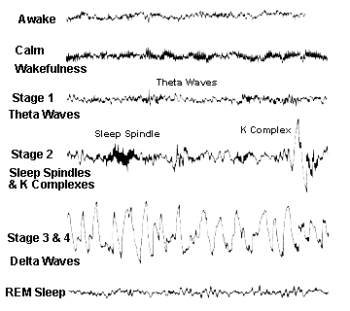
Brain Waves During Sleep
Alpha, Beta, Theta, Sleep Spindles, K Complex and Delta Waves

Slide 16
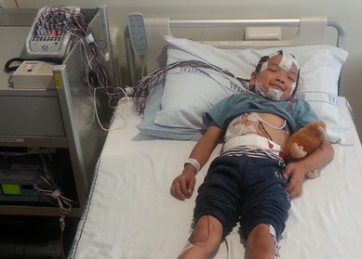
Polysomnogram
Many channels of sleep are recorded. Poly = many Somno = sleep Gram = record

Slide 17
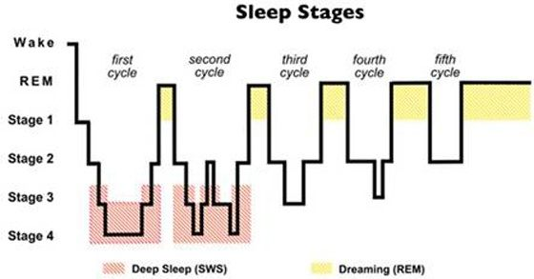
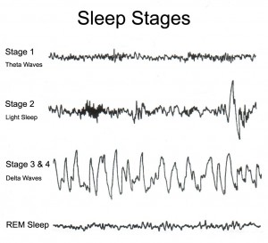
Stages of Sleep
Slow wave deep sleep (Stage 3) occurs mainly in first part of night
REM sleep occurs in mid-latter part of sleep, increases in duration as the night progresses

Slide 18
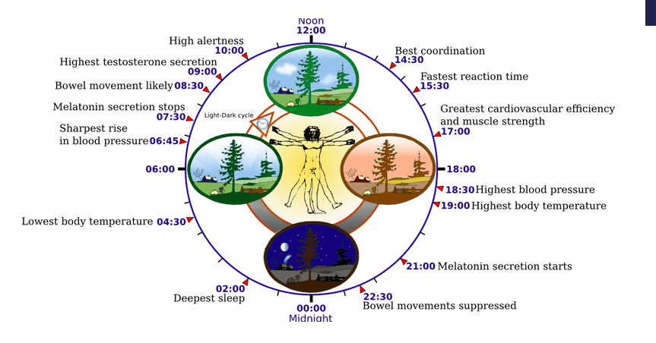
Circadian Rhythm
The body’s biological 24h clock. Decreased light increases melatonin which makes us feel drowsy.
Responsible for Jet Lag

Slide 19
Sleep Disorders
Thought to be about 70 different kinds
Most common ones are: Sleep Apnea, Insomnia, Restless Leg Syndrome, Narcolepsy (hereditary)
Delayed Sleep Phase Syndrome is common in about 15% of teens. Teens are unable to fall asleep until at least 11pm.

Slide 20
Why do we Sleep?
Sleep is necessary for survival
Needed for our nervous system to function properly
Studies show that the normal life expectancy of a rat is 2-3y. Rats deprived of REM sleep survive for 5 weeks on average. Rats deprived of all sleep stages survive for only 3 weeks.

Slide 21
How Much Sleep do we Need?
Infant 18h
Child 12h
Teen 9h
Adult 7.5 - 8 h
Horse 2h
Cow 4h
Rabbit 8h
Dog 10h
Cat 12.5h
Sloth 16h

Slide 22
Sleep Deprivation

Slide 23
Effects of Sleep Deprivation
Increased hunger (due to increased grehlin and decreased leptin) which can lead to weight gain
Decreased mental alertness. Awake for 20h is equivalent to blood alcohol level of 0.1
Decreased memory
Impaired concentration
Erratic emotions (moodiness, sadness)
Decreased immunity therefore increased sickness
Impaired decision making
Skin breakouts increase, dark bags and circles under the eyes

Slide 24
Why are we sleeping less than ever?

Slide 25
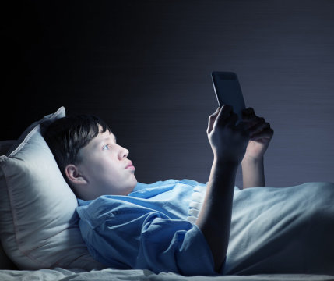
What is keeping us up at night?

Slide 26
Sleep Hygiene
Maintain a regular sleep routine (to bed/wake time should be the same within +/- 20 min)
Avoid naps (decreases ability to sleep at night)
If you can’t sleep within 20 min. of going to bed, get out and do something quiet in a dark room
Exercise daily but no vigorous activity 2h before bedtime (increases endorphins will interfere with sleep)
Quiet cool dark bedroom with comfy bed (white noise is OK)
Do not “clock watch”. Set an alarm and turn the clock away from you
No pets in bedroom if they are disruptive
NO ELECTRONICS IN BEDROOM. Cell phones are sleep killers!

Slide 27
Video: Sleep Health & Mental Health

Slide 28
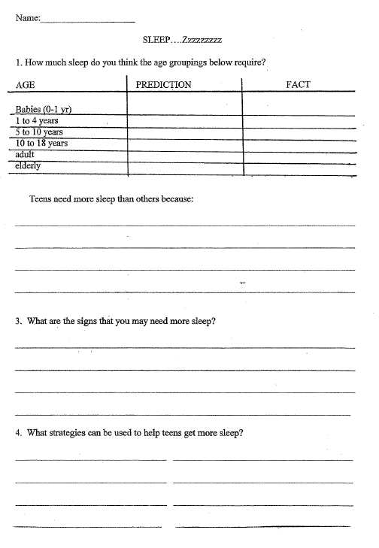
ACTIVITY: EXIT HANDOUT
See what you’ve learned this lesson!
Fill out the handout based on what you’ve heard this block.
Notes:
Print “worksheet on sleep” and handout as a review

Slide 29
A good Night’s Sleep is the First step to a great day
Give your body the sleep it needs.
You will be a happier, healthier person.

Slide 30
Questions ?
Notes:
Question Box time: Have students fill out questions and address them next class.

