Slide 1
Teacher Info Slides
What do I need to know before I teach this material?
Notes:
Student slides start at slide #4

Slide 2
Reminders When Answering Questions:
enders When Answering Questions
Set ground rules ahead of time,
set up an anonymous question box and give yourself time to formulate answers for the next session,
use reliable phrases,
always end with a safety message or direction of a reliable resource for more information,
tell students you may rephrase questions to protect confidentiality and safety of all students (no names, no questions that expose anyone)

Slide 3
Useful Phrases When Answering Questions:
some people may,
although not everyone will…
it’s important to understand the safety of…,
experts believe,
doctors suggest,
the safest way…(always end with safety as the message),
ask your family what their rules are or values are about…,
that’s an interesting question: I bet they might have an answer on one of our trusted websites: let’s find out,
sometimes people think of questions that will shock or gross us out but it doesn’t mean they are safe, true, likely or even possible,
not everything you see or hear about it is true (media literacy),
In this question I wonder if there is consent of each person and if anyone would be in harm (redirect difficult questions to safety)…

Slide 4
Health 6/7 – B Year
Lesson 2: Puberty – Finding out who I am

Slide 5
Let’s review
How do we behave in Health Class?
Notes:
Go over the ground rules as a class – Print handout of rules for students included as well if you want to print it and hand it out

Slide 6
Ground Rules:
This is ‘Body Science!’ Learning about the body is fun and it helps us:
Learn how to care for our own bodies
Understand our body belongs to us and our rights
Helps us get along with other people and not cause harm to anyone else
Teaches us how to get out of unsafe situations and who to go to for help
Be private: no using other people’s names, or personal stories. We only talk about our bodies with people we trust, and trusted adults. This information is only appropriate for your age group and older: do not share with younger kids at lunch who may not be ready for it.
Personal Values: Everyone has their own set of beliefs and family values. Even if our values aren’t the same as someone else’s we still show respect and honour the diversity that exists.
Giggly wigglies: sometimes bodies are funny. If you have to laugh…follow the 3 second rule, take a deep breath and look at the ground until you can join the group again.

Slide 7
Ground Rules continued:
Use scientific terms and words: slang is ok, but always use scientific word as well. Using scientific words teaches a universal language of health.
“Interesting”: doctors never say things are gross, or say “ewww”. Instead they say “interesting…” it’s a good word to use when we don’t know what to say!
No personal questions. This rule saves a lot of embarrassing moments. It’s ok for students and teachers to not answer personal questions.
All other questions are ok: there is no such thing as a bad question in health class. There is a time and a place for questions though. Always have a piece of scrap paper out for you to write down questions that may come up so you can ask them at the appropriate time or submit it anonymously to the question box.
Support: sometimes different feelings may come up and you might need to talk with a counselor or teacher after the lesson.

Slide 8
The classroom is a safe spot for you to share your thoughts and feelings.
We have rules, because we want to make sure everyone is able to share their feelings without fear.

Slide 9
What are all the different stages of life a human goes through?
Notes:
Could Include:
New born
Baby
Toddler
Child
Pre-Teen/Tween
Teenager
Adult
Senior
Elder

Slide 10
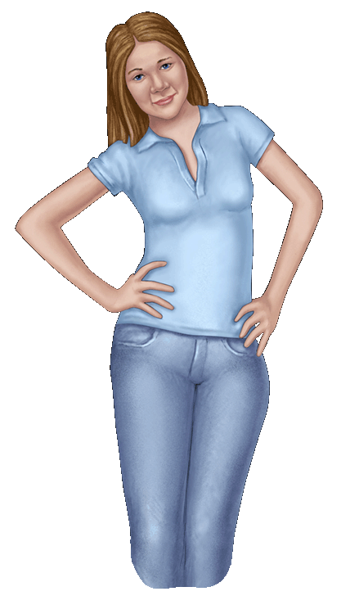
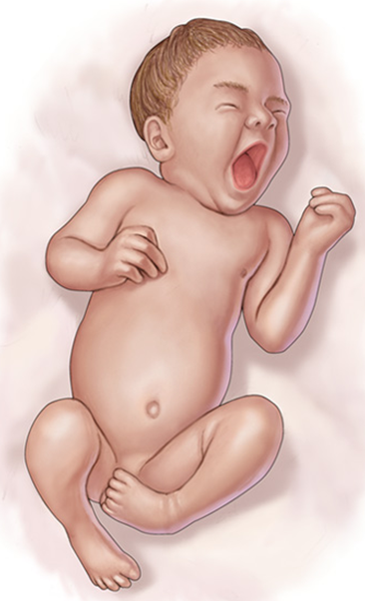
3 Major Growth Spurts
1. Conception to Birth
3. Puberty
2. Birth to one year old
Notes:
When a baby grows, it grows in a uterus for around 40 weeks (sometimes less!)
Grow a lot in first year of life
Grown a lot during puberty (when a body changes from a child to a teenager to an adult)
•about 3 cm/year during puberty but it’s different for everyone!
•
If students ask how a baby gets in the uterus an age appropriate answer could be:
•A baby takes a sperm and an egg coming together to be created. The sperm is made in the testicles and the egg is found in the ovaries. The penis can deliver sperm to the uterus, or this can be done in a laboratory (IVF) then a doctor can place the sperm and egg that have been brought together into the persons uterus

Slide 11
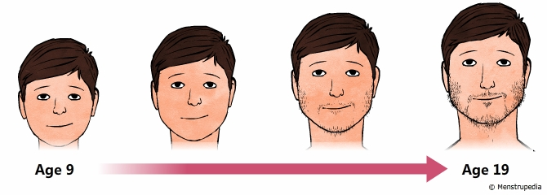
What is Puberty?
Time of change from child to adult
Body reaches maturity
Emotional and physical changes
Bodies develop and become fertile
Notes:
Puberty takes about 6 years from start to finish until body is done growing
What emotions do teens feel more of (sads, mads, glads)
Bodies start practicing new functions that mean the body is capable or having a baby, but…
•but it’s just practicing: a person’s brain isn’t fully developed until around 21-26.
•People still need lot’s of practice learning about how to have healthy relationships first.
•Some people have children when they are younger, some when they’re older, some never! You get to decide if you want to have children or not

Slide 12
What Does Fertile Mean?
Testicles start to make
sperm cells
Ovaries start to make
egg cells

Slide 13
When a sperm enters the egg cell, a baby is formed.

Slide 14
When do I start puberty?
What are some ages people might notice body changes starting?
8--------- 14
10-------- 16
12-------- 18
14-------- 20
15-------- 21
What age will my body stop growing?
Notes:
Puberty starts anywhere between the ages of 8-15 but as young as 6 and as late as 18
•Everyone is different
•Everyone will start and finish at a different time
•Takes about 6 years
Note for teachers: for some trans people, they may take puberty blockers (if so, the younger the better), and in some cases take other hormones. This may delay puberty

Slide 15
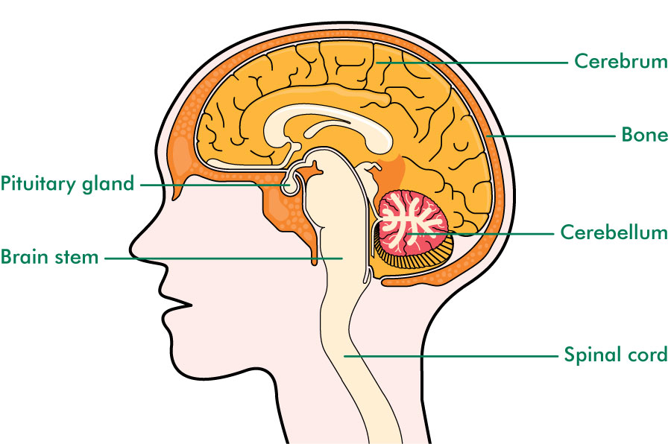
What Makes Puberty Start?
The pituitary gland sends a signal to the body to produce the hormone that starts puberty.
Notes:
Male (or those people who have testicles or a penis) hormone – Testosterone
Female (or those people who have ovaries or a vulva) hormone – Estrogen
*note, for some trans people, they will crave the hormone that their brain is (i.e. if they have a male brain-identify as male, they will crave testosterone) In some cases trans folks will take hormone suppressors or take hormones.
Image source: https://www.google.ca/search?q=free+clipart&tbm=isch&tbo=u&source=univ&sa=X&ved=0ahUKEwiUu-Sl1NbSAhWk7oMKHQCwB_sQsAQILw&biw=1366&bih=657#tbm=isch&q=free+clipart+pituitary+gland+in+children&*&imgrc=6E17akeiyDUdsM:

Slide 16
Does Everyone Produce the Same Hormone?
If you have ovaries, the pituitary gland sends a signal to produce Estrogen.
If you have testicles, the pituitary gland sends a signal to produce Testosterone.
Notes:
Every body has both of these hormones in them. The body parts you are born with will determine which hormone your body will make even more of!

Slide 17
How does my body change during puberty?
Stairs Spurt
Ninja Spurt
Bean Sprout Spurt
Shocker Spurt
Which one do you think you’ll be like?
Notes:
Can draw visuals of this on the board:
Stairs: grow in chunks then take a break, then another chunk, then a break (always outgrowing clothes)
Ninja: slow steady growth
Bean Sprout: grow like a foot over the summer
Shocker: one of the last to grow, then all of a sudden end up the tallest at the end of high school

Slide 18
VIDEO: Puberty – Finding out who you are

Slide 19
Some Body Changes for everyone
Oily hair
Acne or pimples on skin
Body odor
More sweating
Body hair
Notes:
These puberty changes can happen to everyone who is going through puberty. Not everyone will have the same amount but it will happen in different amounts to everyone.

Slide 20
Some body changes for people with vulvas:

Slide 21
Physical Changes for people with a Vulva:
Often starts around 9-13 years old
Get heavier and taller
Breasts start to develop
Hips get wider (body fat is re-arranged to round out hips and thighs)
Face gets longer
Voice gets a bit deeper
Grow pubic hair, arm pit hair, and body hair
Start to sweat more/smell more
Skin and hair may get oily
Sex organs develop/grow
Period starts
Vaginal fluid produced
Pimples
Notes:
These puberty changes can happen to everyone with a vulva

Slide 22
Some body changes for people with penis’:

Slide 23
Physical Changes for people with a Penis:
Often starts around 11-14 years old
Body grows heavier and taller
Face gets longer and wider
Voice gets deeper (voice box grows)
Grow pubic hair on genitals
Start to sweat more/smell more
Penis and testicles will get bigger (testicles grow first)
Start making sperm (around age 9)
You might get pimples and oily hair and skin
More hair on body, including face/arm pits
Possible breast development (will spread out when ribs expand, and shoulders widen
Notes:
These puberty changes can happen to everyone with a penis

Slide 24
VIDEO: Period Talk
Notes:
A large amount of the population menstruates, and it is good for everyone to know what is used to deal with these things.
Feel free to use the sexual health kit and show students these different items after the video.
Kit should include tampons, pads, and menstrual cups.

Slide 25
Things to remember about Puberty:
It’s OK to feel terrific one moment and down in the dumps the next
You will want more independence but expect some disagreements over boundaries with parents/ significant others
You will feel different about how you look – remember that right now your body is a work in progress and enjoy the changes as you experiment with clothes, hair and make-up
It is normal to feel worried about whether people like you or not and sometimes you may feel left out. Talk it over with your friends or family.
You may start to have sexual feelings and as you grow older these
feelings may become stronger
COMMUNICATE with family and friends. Your friends may be feeling the same way and it helps to share experiences and ways of coping
Notes:
Summarize the lesson by making the following points

Slide 26
Questions ?
Notes:
Question Box time: Have students fill out questions and address them next class.

